Slide 1

Mass Software Upgrade (MSU)
The Proposal

Slide 2

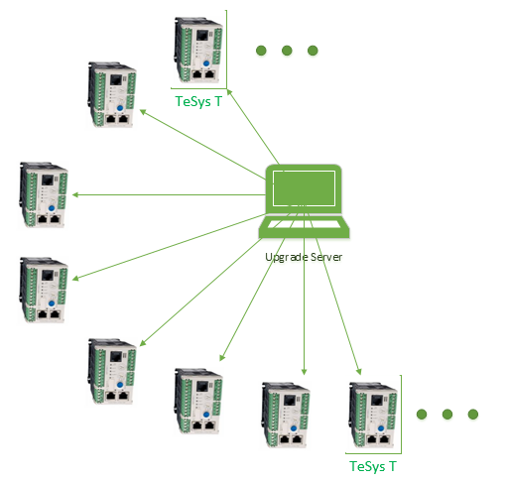
The Case Studies
Case 1:
TeSys-T had a firmware issue due to which 7000 devices had to be reprogrammed.
Problem:
Using the conventional methods of Upgrade using FTP, upgrading 7000 devices can take 24 days! Considering 5 minute for 1 device
Case 2:
Gemasolar plant has 2650 devices for mass upgrade.
Problem:
Using SGBackup tool, it takes 6 hours to upgrade 2650 devices. There are plans to add yet another plant with 10000+ devices, further increasing the maintenance time requirement.
The Catch:
Maintenance in a typical solar power plant is allowed 8-10 hours (non-operating hours in the day when there is no sunlight).

Slide 3

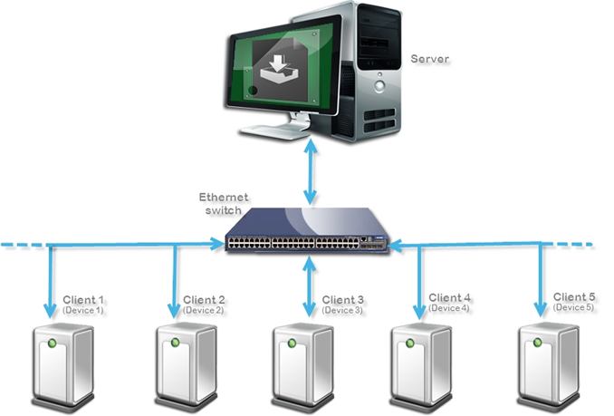
Mass Software Upgrade (MSU) Protocol
The Mass Software Upgrade protocol is implemented on the client devices onto which the upgrade is performed by the MSU Server.
The protocol enables the same mass upgrade at an exponentially small time. For the TeSys T case, MSU can perform the upgrade for 7000 devices in 2.3 hours!
This is achieved by creating 28 batches each of 250 devices, 28 cycles taking 28* 5 minutes = 2.3 hours.

Slide 4

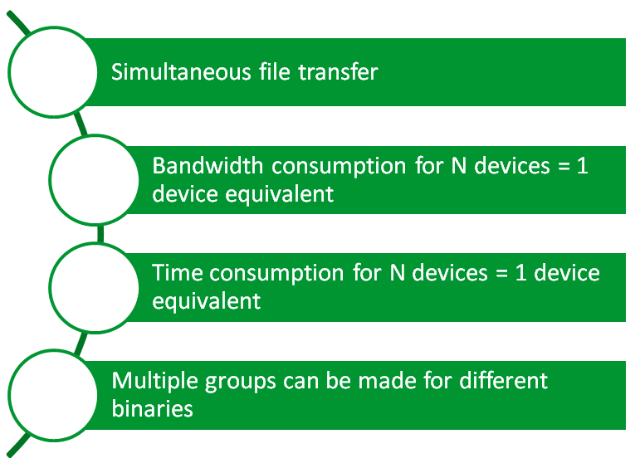
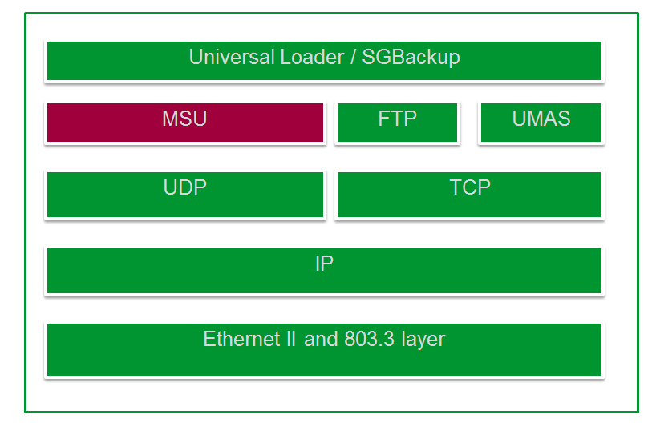
Why MSU?

Slide 5

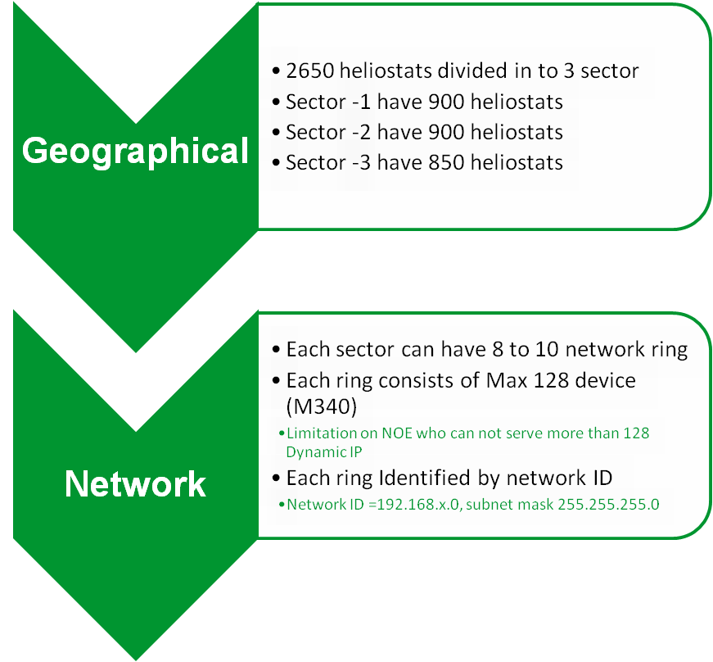
Gemasolar Use case
Ring | Network | Subnet mask | Heliostats
N01 | 192.168.11.0 | 255.255.255.0 | 109
N02 | 192.168.12.0 | 255.255.255.0 | 119
N03 | 192.168.13.0 | 255.255.255.0 | 105
N04 | 192.168.14.0 | 255.255.255.0 | 105
N05 | 192.168.15.0 | 255.255.255.0 | 124
N06 | 192.168.16.0 | 255.255.255.0 | 106
N07 | 192.168.17.0 | 255.255.255.0 | 113
N08 | 192.168.18.0 | 255.255.255.0 | 69
E01 | 192.168.19.0 | 255.255.255.0 | 105
E02 | 192.168.20.0 | 255.255.255.0 | 119
E03 | 192.168.21.0 | 255.255.255.0 | 106
E04 | 192.168.22.0 | 255.255.255.0 | 106
E05 | 192.168.23.0 | 255.255.255.0 | 106
E06 | 192.168.24.0 | 255.255.255.0 | 106
E07 | 192.168.25.0 | 255.255.255.0 | 73
E08 | 192.168.26.0 | 255.255.255.0 | 71
E09 | 192.168.27.0 | 255.255.255.0 | 108
O01 | 192.168.28.0 | 255.255.255.0 | 105
O02 | 192.168.29.0 | 255.255.255.0 | 119
O03 | 192.168.30.0 | 255.255.255.0 | 106
O04 | 192.168.31.0 | 255.255.255.0 | 106
O05 | 192.168.32.0 | 255.255.255.0 | 106
O06 | 192.168.33.0 | 255.255.255.0 | 106
O07 | 192.168.34.0 | 255.255.255.0 | 73
O08 | 192.168.35.0 | 255.255.255.0 | 71
O09 | 192.168.36.0 | 255.255.255.0 | 108

Slide 6


Existing Solution
SGBackup | MSU
Aprox 30 minutes per Step | Aprox 5 Minute per step
30*13ring =390Min=6.5Hr | 5*13ring =65Min= 1.1Hr
Server
Primary Network
Step-1
Step-2
Step -n
Subnet-1
Subnet-2
Subnet-n
D-1
D-254
D-1
D-254
D-1
D-254
D-2
D-253
D-2
D-253
D-2
D-253
D -128
D-129
D -128
D-129
D -128
D-129

Slide 7

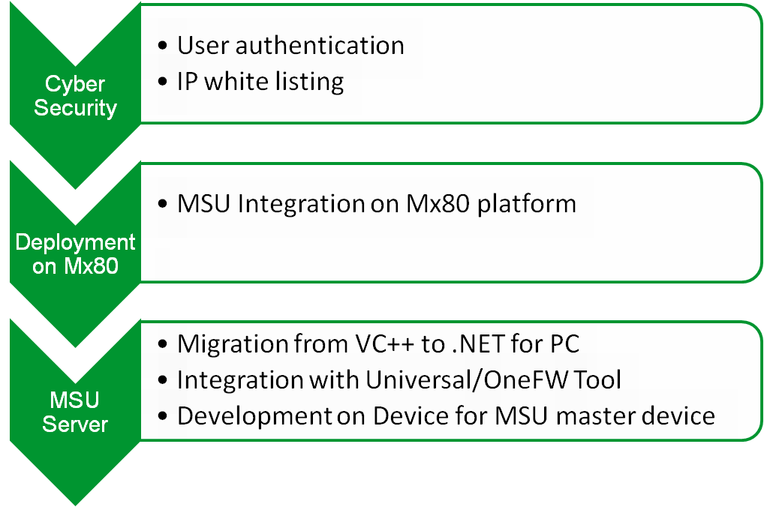
The Road Ahead

Slide 8
The Road Ahead
MSU
Aprox 5 Minute per step
5Min+5Min = 10 Min
254*254 = ~64000 device in 10 Min
Server
Primary Network
Step -1
Subnet-1
Subnet-2
Subnet-255
MSU
MAS-1
MSU
MAS-2
MSU
MAS-255
Step-2
D-2
D-254
D-2
D-254
D-2
D-254
D-128
D-129
D-128
D-129
D-128
D-129

